Slide 1

Giving a Presentation
How to give a good presentation
How to give a good peer review feedback
School of Computing and Information
Department of Computer Science

Slide 2
Presentation Logistics
We’ll have 2 presentation sessions per day
15 minute talk
5 - 10 minutes Q & A
All talks must be emailed to me by Thursday midnight the day before your presentation
Preferred format: PDF
Alternative format: Powerpoint
Please put a cover page with title, name, and project (So that reviewer knows who you are and where you worked)
Please number your slides

Slide 3
Now let’s talk about giving a good talk

Slide 4
Outline
Why am I presenting in front of all these people?
How to structure my talk
Issues you want to avoid
Slide Design
Slide Delivery

Slide 5
Outline
Why am I presenting in front of all these people?
How to structure my talk
Issues you want to avoid
Slide Design
Slide Delivery

Slide 6
Why am I presenting in front of all these people?
You have experience worth sharing with your peers
Your internship was valuable one way or another
Disseminate value to your peers (you know, like a TED)
Could be …
Detailed design of a product; What happens behind the scenes to make it work? Why was a certain tech used and not something else?
Software development methodology; How did you feel about it? Did it increase productivity?
A new interesting job category; How does it compare to SW developer? Did you like it?
Any challenges you faced and how you solved them; Can be technical, interpersonal, organizational

Slide 7
Why am I presenting in front of all these people?
To gain practice in giving a technical talk
Learn how to structure your ideas
Learn how to design slides effectively
Learn how to deliver your ideas impactfully
You have an active role in giving peer reviews on where your friend needs to improve in the future

Slide 8
Why am I presenting in front of all these people?
NOT to report your internship to your instructor
If that was the purpose, I would not have 20+ busy people sit down with me while you talk
That purpose is already fulfilled by your report
Your presentation should be directed at your peers, not at your instructor

Slide 9
Outline
Why am I presenting in front of all these people?
How to structure my talk
Issues you want to avoid
Slide Design
Slide Delivery

Slide 10

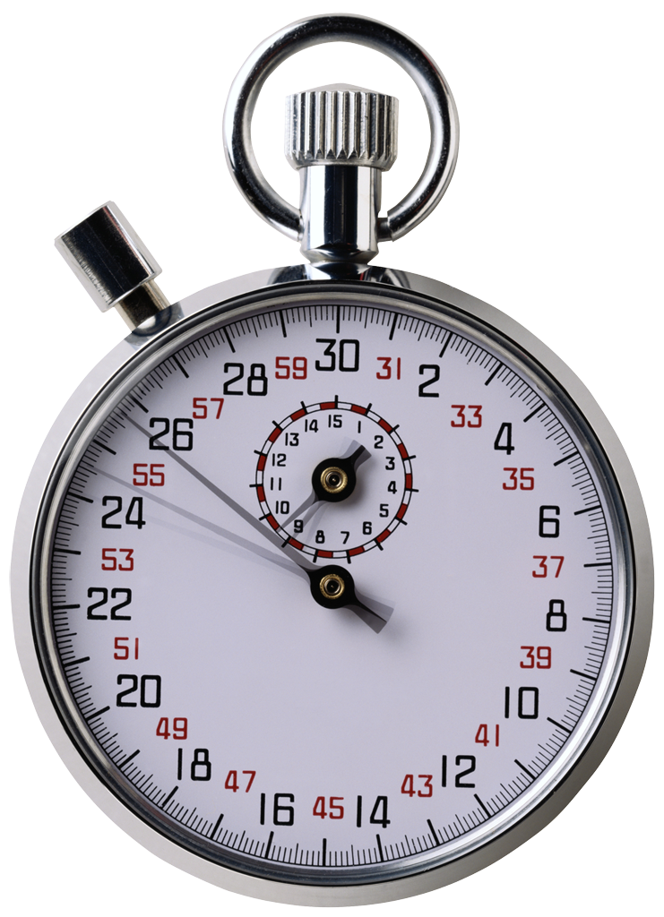
Structure your talk based on your audience and the time that you have
Your audience: Generally smart individuals
Computer Scientists? Yes
Knowledgeable about your area? Maybe
Knowledgeable about your problem? Probably not
Time is usually limited
Invited talk: < 1 hour
Conference talk: 20 minutes or so
Elevator talk: < 2 minutes
Your talk: 15 minutes
This is not a lot of time…
Bottom line: Your audience should learn something from your talk

Slide 11



That’s not a lot of time, how should I structure my talk to relate to these people?
This is a hard problem…
… with interesting applications…
… that builds on prior work…
Two sub-parts:
You solved a problem
You used neat technological advancements to do this

Slide 12
Give context and big picture
Do not lose sight of the big picture
Audience should always know where you are taking them
Why are you telling me this? Where does it fit in?
Audience may need refocusing from time to time
Give context
Don’t just say I did this and I did that
How did it help your organization?
How did it help the end-user?
What considerations went into the decisions?
What constraints did you have?

Slide 13
Outline
Why am I presenting in front of all these people?
How to structure my talk
Issues you want to avoid
Slide Design
Slide Delivery

Slide 14
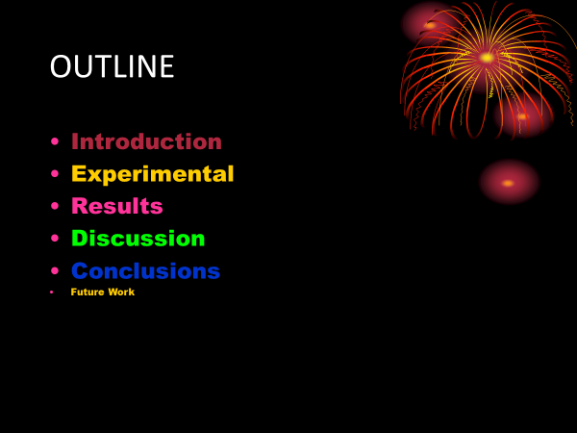
Admire my beautiful slide

Slide 15
Admire my beautiful slide
A slide is not a work of art – curb your enthusiasm
Fonts, colors, and style should be consistent
If not, the difference should convey a meaning
Also remember, a portion of population is color blind
By the way, was that outline slide really necessary?
Most talks are structured that way – no information content

Slide 16
Look at my code, my code is amazing

Slide 17
Look at my code, my code is amazing
Hate to break it to you but …
Nobody wants to read your code (if avoidable)
Nobody wants to read your code (if not avoidable)
If you really feel the need …
At least explain at a high level what the code is trying to do
Focus audience attention at the part that is interesting

Slide 18
Towers of Hanoi
Move all disks from a tower to another. You can use a third temporarily.
src
temp
dest
Move n-1 disks into “temp”
Move 1 disk into “dest”
Move n-1 disks into “dest”

Slide 19
By the power of recursion!!!
Recursive solution for the Hanoi towers
void solve_hanoi(n, src -> dest, temp)
{
if (n == 0) return;
solve_hanoi(n-1, src -> temp, dest);
move(1, src -> dest);
solve_hanoi(n-1, temp -> dest, src); }
Solve moving 0 disks!
Moving one disk is easy
Solve moving n-1 disks with the power of recursion!

Slide 20
I am a math whiz

Slide 21
I am a math whiz
Well guess what. Many are not.
Translate math to plain English whenever you can
At least highlight what matters, and what is the take home message
Increasing the elements of decreases the value of the function

Slide 22
Just read my text
Proof sketch:

Slide 23
Just read my text
Then why am I listening to you?
Having too much to read can interfere with listening
Did you know? Reading and listening exercise the same part of the brain

Slide 24
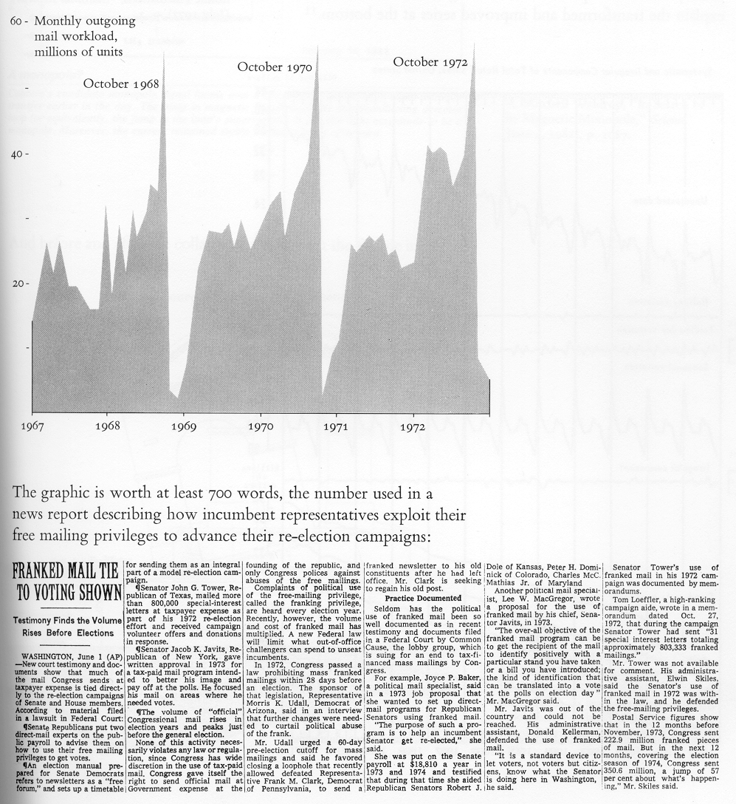
A picture is worth a thousand words But only if you explain it!
Don’t leave a picture hanging there and expect your audience to interpret it
If you have something on your slide that you don’t explain, it is just noise.

Slide 25
A picture is worth a thousand words But only if you explain it!
Put in graphical cues to focus attention
Actually point to the figure and explain
Interpret the figure on behalf of the audience
Election year
Number of letters sent by congress.

Slide 26

Acronyms and jargons are useful But only if you explain them!
IMHO, ARE = ADIH. TBH, FUBAR & 2M2H.
Translated: In my humble opinion, an acronym rich environment is another day in hell. To be honest. Its f***ed up beyond all recognition and too much to handle.

Slide 27
Outline
Why am I presenting in front of all these people?
How to structure my talk
Issues you want to avoid
Slide Design
Slide Delivery

Slide 28

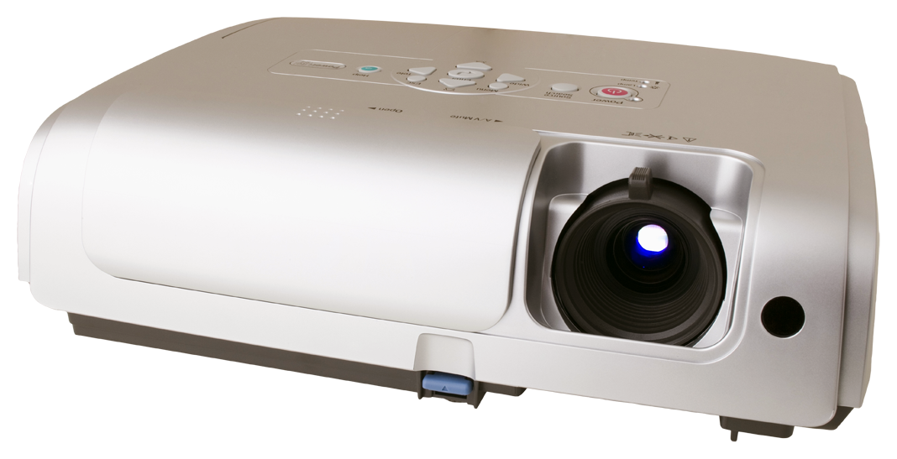
It’s not just what you say, but how you say it
Body language says a lot
Make eye contact with your audience
Corollary: Face your audience
Some movement is good
Don’t speak too fast (or too slow!)
Make useful slides
One primary idea per slide
Use slide titles to convey take-away message
Do not read your slides!
But put all important information there!

Slide 29
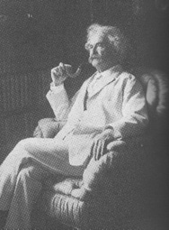
Practice, Practice, Practice
Practice makes better
Alone: Work on your “script,” smooth out transitions
Peer group: Get used to other people being around
Broader population: Assess outsider comprehensibility
“Flash” is good, but too much flash is distracting
Good: Animations to progressively build diagrams
Bad: Animating every slide transition, every line
Make sure you refer to every item on a slide
If you don’t, it is always better to remove that item
It takes three weeks to prepare a good ad-lib speech

Slide 30
Let’s Critique some Real Slides
From anonymous previous Capstone students

Slide 31
API With Purchase Document
Response

Slide 32
Projects
Food and Beverage / Retail Software
Software: Android Studio
Server: MySQL
Worked on UI and worked to add functionality and new features
Fix bugs
Lib Project
Work on developing library that would send information to various hardware devices
Work with code on both sides to tweak it so it follows the specs
Actually released lib to other software houses for internal testing

Slide 33







Technologies

Slide 34


Project Overview
VersionOne Migration to Jira
Why?
VersionOne is slower and inefficient
VersionOne is more expensive
Jira is compatible with other technologies that PNC uses
PNC originally migrated from Jira to VersionOne manually, which resulted in the loss of images, conversations, and time.
Our Task
Create a self service migration tool to automate the process
Ensures that all information is carried in this migration process, such as conversations, images, etc.
Notes:
VersionOne is more expensive because it requires the purchase of the entire package, in which PNC may not want to use all of the functionalities. In Jira, you can select which functionalities to purchase.
Jira was under the same company of other technologies that PNC uses, such as Mattermost, Confluence, etc. (Atlassian?)

